Slide 1
Team 9
{Rupali,Sowmya}

Slide 2
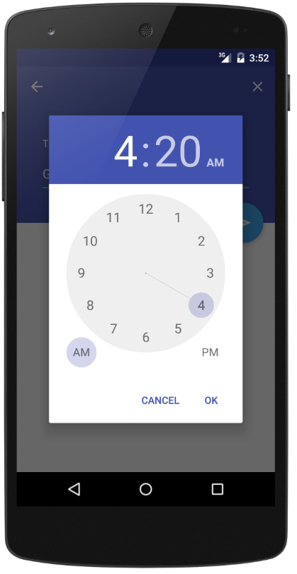
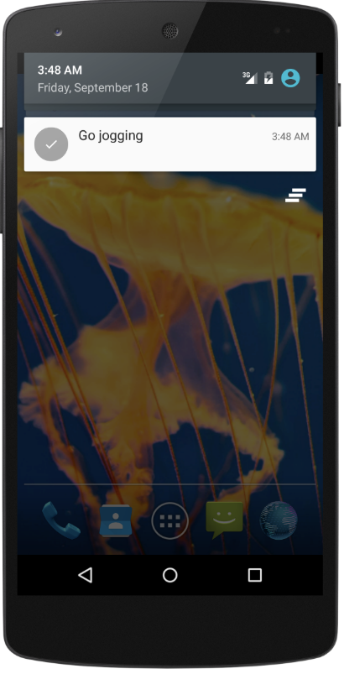
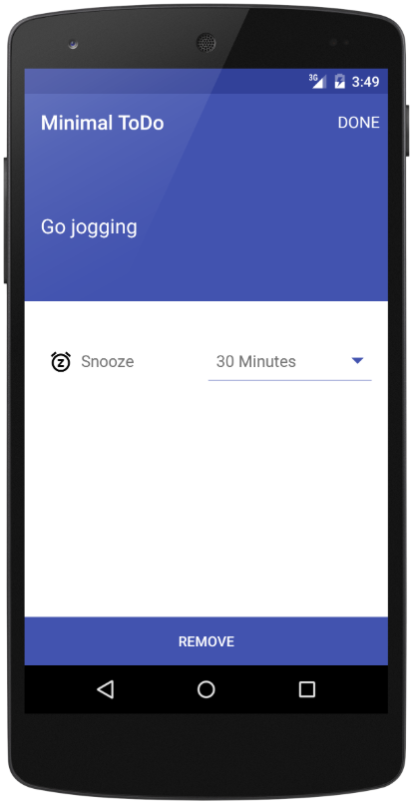
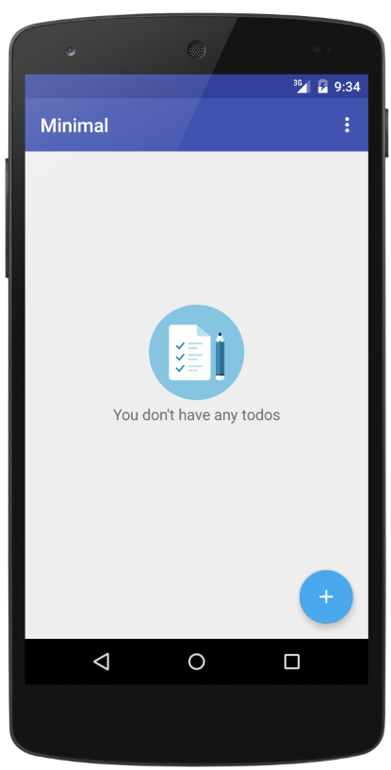
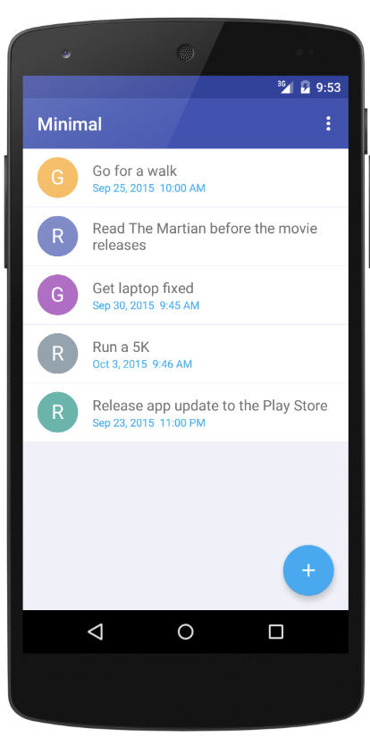
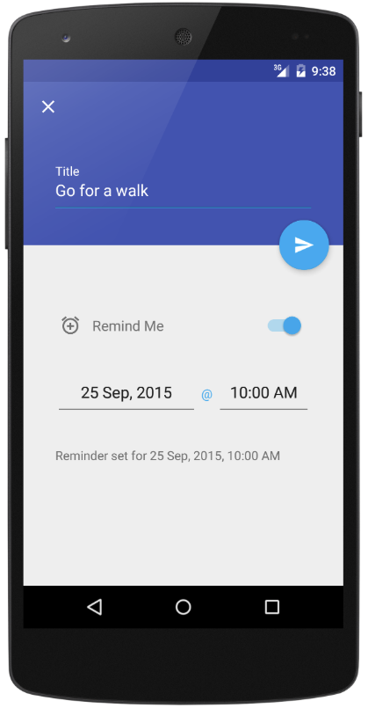
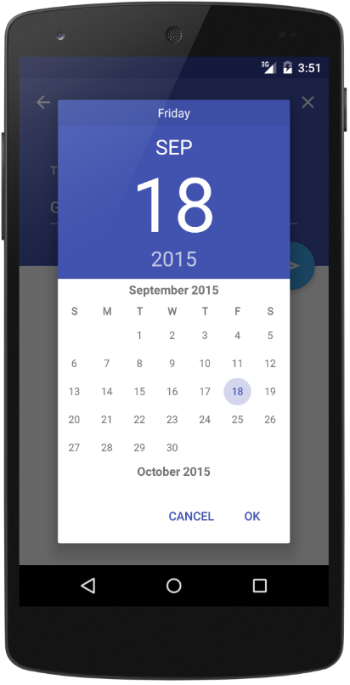
Android Minimal - TODO
https://github.com/avjinder/Minimal-Todo

Slide 3
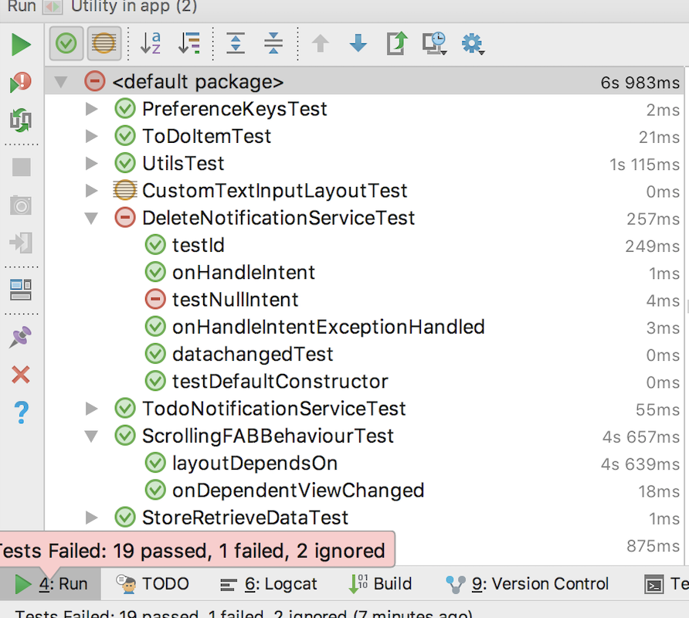
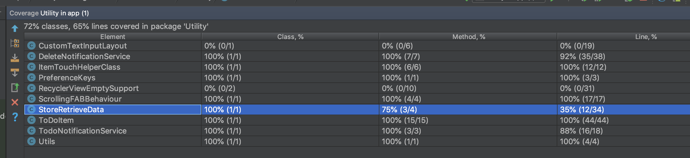
Unit Testing and Code Coverage

Slide 4
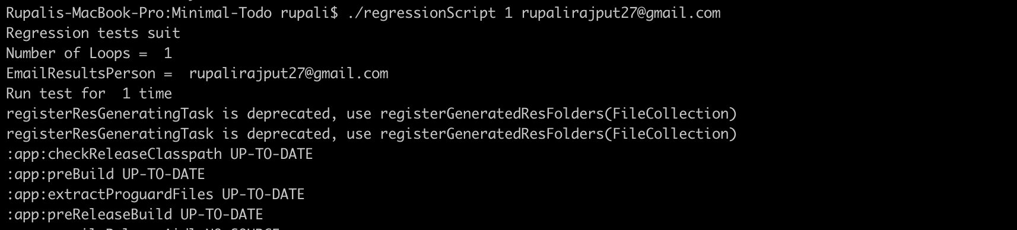
Regression Testing

Slide 5
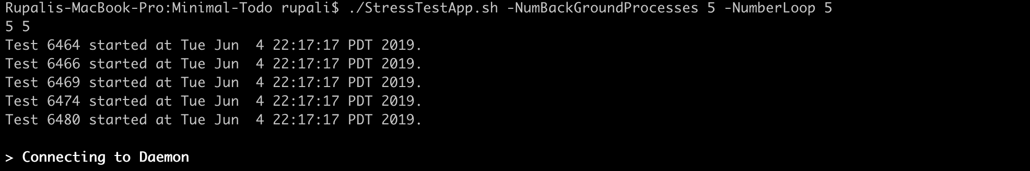
Stress Testing
Stress testing is the process of determining the ability of a computer, network, program or device to maintain a certain level of effectiveness under any conditions.
In our app, we have done stress testing for 100 Processors and 100 loops. It takes around 115mins to complete the entire activity.
./StressTestApp.sh -NumBackGroundProcesses 5 -NumberLoop 5

Slide 6
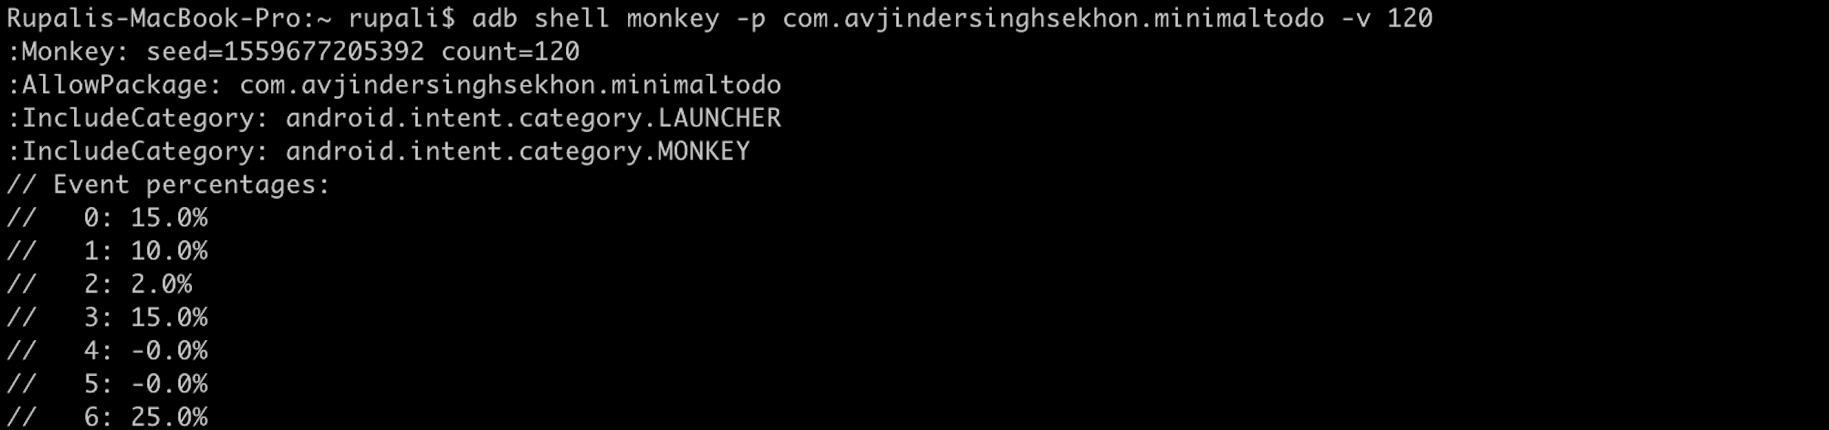
Monkey Testing
The Monkey is a command line tool that runs on your emulator or device and generates random streams of user events such as clicks, touches, or gestures.
You can run monkey command from shell environment: $ adb shell monkey [options] <event-count>

Slide 7
Experiences and Lessons Learned
We faced lot of challenges surrounding the infrastructure and using several tools for the first time while doing this android application testing.
Understood and utilized the use of mock objects, fake objects and then how to control the behavior of the mocks to test for all possible cases.
Another learning was to understand how to trigger and build test cases for the entire project.
Also, we learnt that tests are not a cover for badly written code. We had to change several classes to get them to be test compatible.

